Slide 1
Life Skills
Your Role as a Caregiver in Providing Life Skills to Youth ages 13 & up

Slide 2
Life Skills for Youth Ages 13-15
Life Skills Reimagined is an interactive online curriculum that covers a wide range of life skills topics for youth and young adults.
Examples of Series (each with multiple courses)
Personal Finance
Resiliency Courses
Communication Skills Courses
Getting and Keeping a Job Courses

Slide 3
Communication Course- Managing Negative Emotions
Overall Sections include a baseline quiz, multiple courses, and a posttest. There are application guides and resource documents included with many courses as well.
https://flnwfhealth-lyftlearning.talentlms.com/index

Slide 4
How to get youth registered for Life Sills Reimagined?
Send an e-mail to lisa.Aufdencamp@nwfhealth.org including the following information:
Youth Name
Date of Birth
E-mail to be used as login and receive information about Life Skills Reimagined.

Slide 5
Other Ways to Support Life Skills
Ages 13-15
*Help prepare basic meals in the kitchen
*How to sort, fold, and put away laundry
*How to wash dishes, load/use/unload a dishwasher
*Personal grooming- how often to shower, brush teeth, use deodorant and the importance
*How to eat healthy- what makes a balanced diet
*Importance of physical activity- 30 minutes of movement a day
*Cleaning- basic understanding of what cleaning products are used for what and how to clean bathrooms, bedding, floors, countertops, etc.
*Allow the youth to start learning how to talk on the phone and how to ask for things needed
Ages 16-17
* Money management- take the youth to the bank and discuss the functions of a bank
*Give allowance and help set a budget to save/spend certain amounts
*Help youth call and schedule their own doctor’s appointments- explain the importance of having a primary doctor and well-checks
*Allow the youth to plan meals, grocery shop and prepare those meals
*Teach the youth how to read medication bottles and understand dosages
*Help youth write a resume, fill out job applications and discuss/practice how to answer interview questions
*Help youth with organization/time management by helping them write a list of tasks and set time frames for completion
*How to take care of a vehicle- pumping gas, regular maintenance, how to call for help if needed

Slide 6
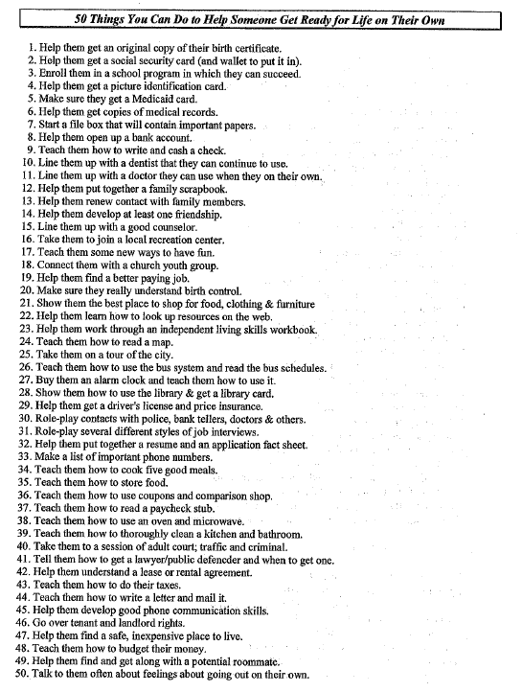
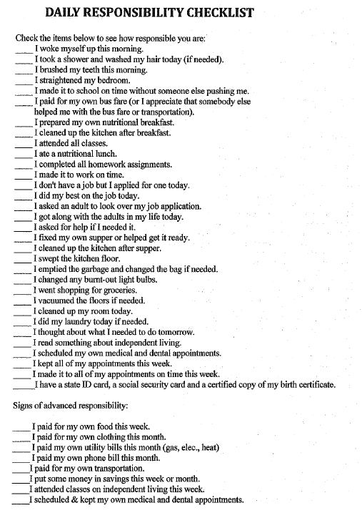

Slide 7
Life Skills for Youth Ages 16 & 17
Life Skills Reimagined is available for youth ages 16 & 17 with the addition of the following life skill options:
Monthly In-Person Life Skill Events– These events are hosted by the Independent Living Team and cover a wide range of topics.
Success Planning- Beginning at age 16, Success Plans are formed with the youth by Youth Specialists. These plans discuss the youth’s short-term and long-term goals and go over major life skill areas. During these plans is another opportunity to assess strengths and needs related to the youth’s life skills.

Slide 8
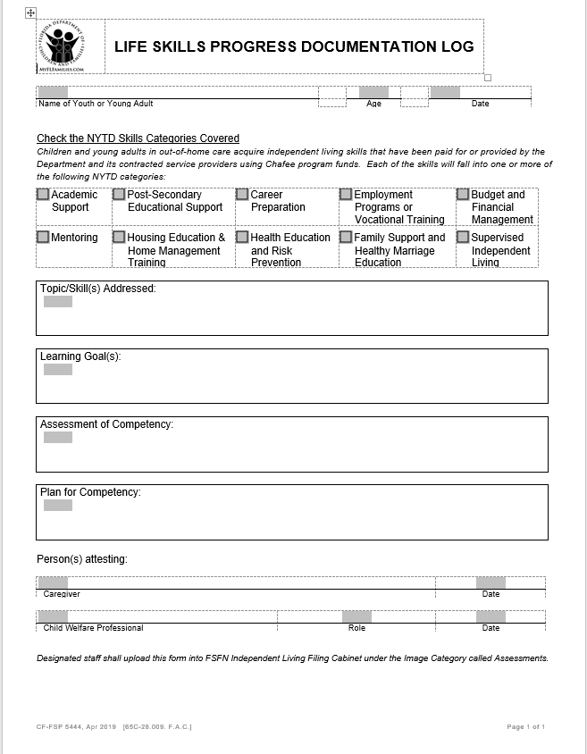
How are Life Skills documented?
Caregiver begins filling out Life Skills Progress Documentation Log, discusses with and provides log to Case Management during home visits. Discussions should include any specific areas of improvement or additional support the youth may need and plans for that support.

Slide 9
Life Skills in Case Plans/ Judicial Reviews
For youth ages 13-17, the Case Plan shall include a task such as “Caregiver will insure the youth has the skills needed to successfully transition to adulthood.”
Assessing the above task in Judicial Reviews includes a statement from the caregiver regarding the youth’s progress on life skills or any specific life skill needs.
For youth ages 15-17, the Case Plan shall include an additional such as “Caregiver will insure the youth has been given the opportunity to obtain his/her learner’s permit/driver’s license.”
Assessing this task in the Judicial Review should include status of enrollment in Keys to Independence and progress on obtaining learner’s permit/driver’s license.

Slide 10
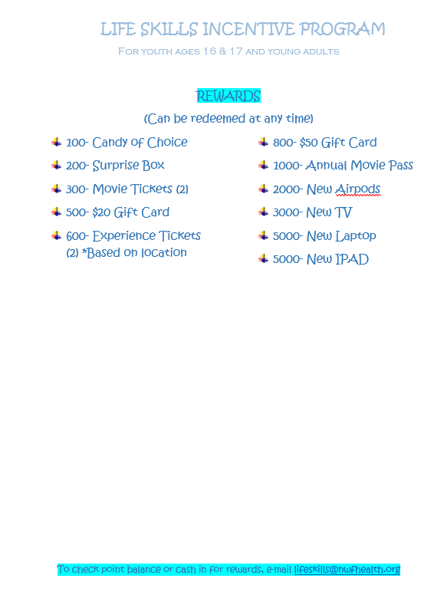
Incentives for Life Skills

Slide 11
Youth Services Team
Tyrone Cleveland
Circuit 14 Youth Specialist
tyrone.cleveland@NWFhealth.org
Cell (448)500-2066
Michael Curry
Circuit 2 Youth Specialist
michael.curry@NWFhealth.org
Cell: (850) 378-6374
Shatigra Howard
C2 & C14 Independent Living Support Worker
shatigra.howard@NWFhealth.org
Cell: (850) 596-3135
Lisa Aufdencamp
C2 & C14 Independent Living Operations Specialist
lisa.aufdencamp@NWFhealth.org
Cell: (850) 728-8818

